Slide 1



Pizza_sales_dashoard
View in Power BI
Last data refresh:
12/26/2023 5:47:59 AM UTC
Downloaded at:
12/27/2023 4:22:16 PM UTC

Slide 2
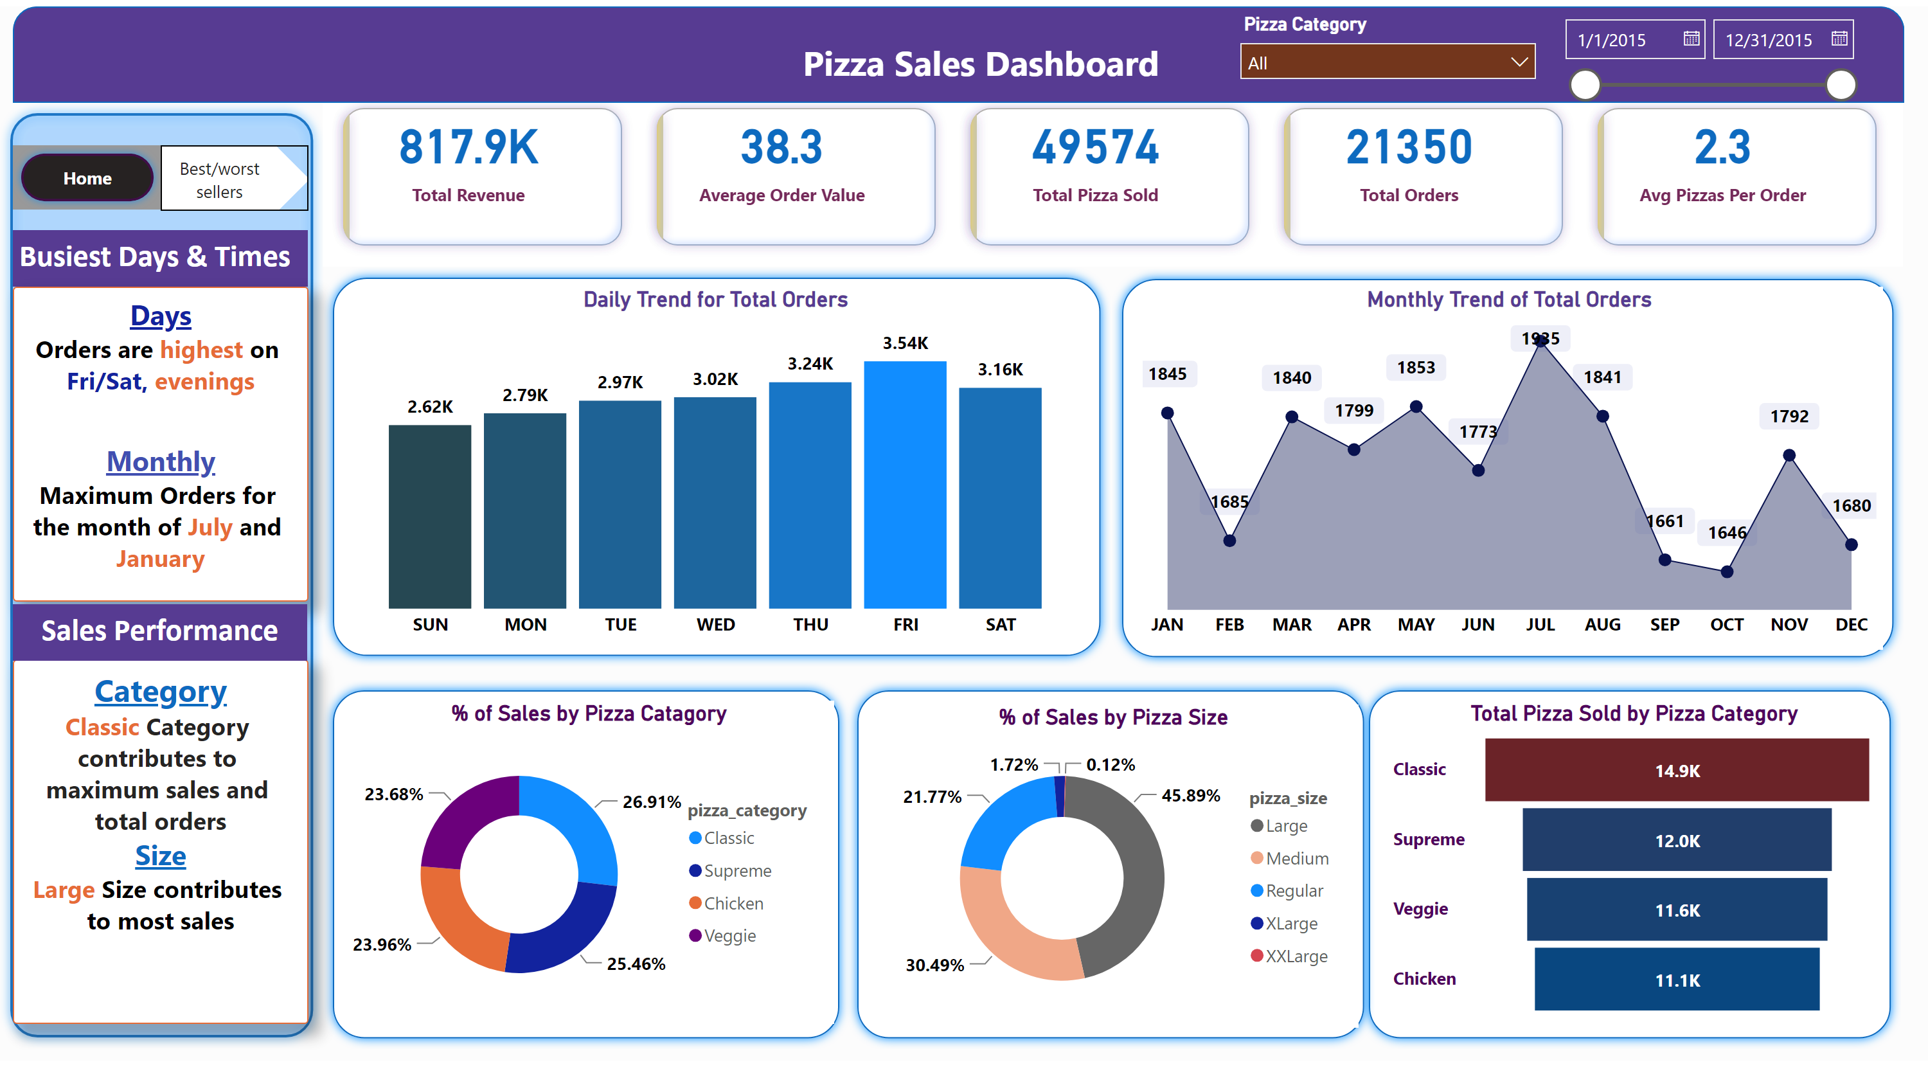
Home
Notes:
pageNavigator
No alt text provided
pageNavigator
No alt text provided
slicer
No alt text provided
slicer
No alt text provided
textbox
No alt text provided
textbox
No alt text provided
textbox
No alt text provided
textbox
No alt text provided
shape
No alt text provided
Total Pizza Sold by Pizza Category
No alt text provided
% of Sales by Pizza Size
No alt text provided
% of Sales by Pizza Catagory
No alt text provided
shape
No alt text provided
shape
No alt text provided
shape
No alt text provided
Monthly Trend of Total Orders
No alt text provided
shape
No alt text provided
Daily Trend for Total Orders
No alt text provided
shape
No alt text provided
textbox
No alt text provided
shape
No alt text provided
cardVisual
No alt text provided

Slide 3
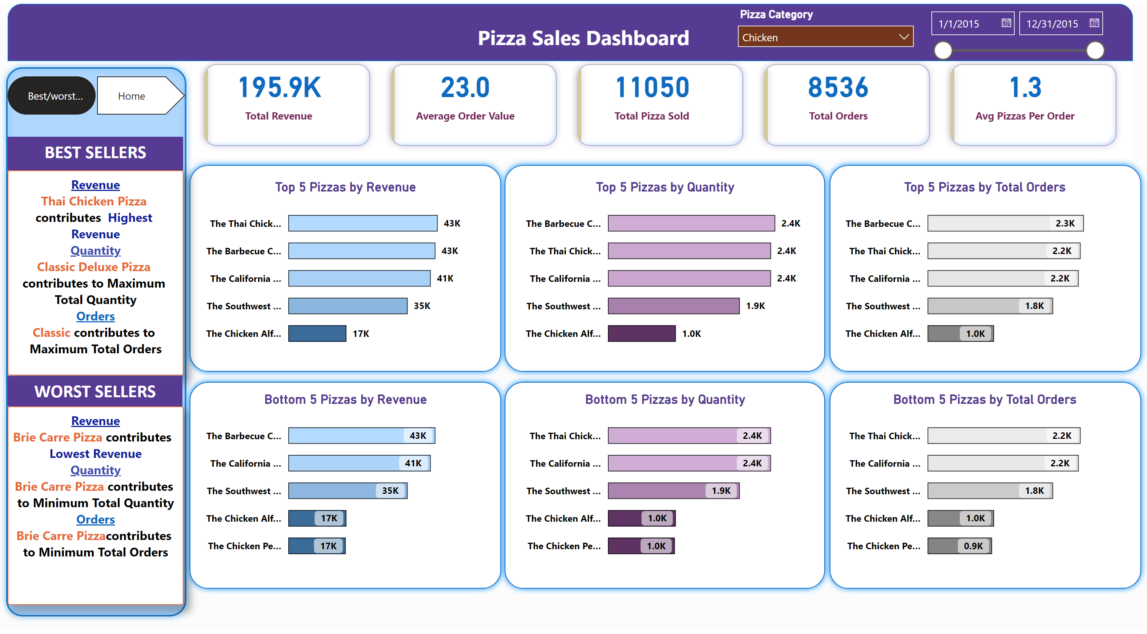
Best/worst sellers
Notes:
cardVisual
No alt text provided
shape
No alt text provided
textbox
No alt text provided
shape
No alt text provided
shape
No alt text provided
textbox
No alt text provided
textbox
No alt text provided
textbox
No alt text provided
textbox
No alt text provided
slicer
No alt text provided
slicer
No alt text provided
shape
No alt text provided
shape
No alt text provided
shape
No alt text provided
shape
No alt text provided
shape
No alt text provided
Top 5 Pizzas by Revenue
No alt text provided
Bottom 5 Pizzas by Revenue
No alt text provided
Top 5 Pizzas by Quantity
No alt text provided
Bottom 5 Pizzas by Quantity
No alt text provided
Top 5 Pizzas by Total Orders
No alt text provided
Bottom 5 Pizzas by Total Orders
No alt text provided
pageNavigator
No alt text provided
pageNavigator
No alt text provided

